Slide 1
Hockey Database
By : Patrick McCardle

Slide 2
My Tables
There are 3 nation-wide recognized leagues of men’s professional ice hockey in the United States.
National Hockey League (NHL)
American Hockey League (AHL)
East Coast Hockey League (ECHL)
There are many other smaller professional leagues, but I am focusing on these ones because they are the “premier” leagues and they are all linked to each other

Slide 3
My Tables cont..
So for my database I currently have 5 full tables
2018 Standings
NHL team information (city, name, mascot)
AHL team information (city, name, NHL affiliate)
ECHL team information (city, name, affiliate)
Favorite team 2018 information (player, age, position, gp, g, a, p, +-, pim)

Slide 4
My Tables cont..
But I plan on adding 2 more.
One table with arena statistics (capacity, year built, avg food/drink price)
And one table with trophy statistics (what for, year created, top recipients)

Slide 5
Isolation and Integrity
Read committed - allows the data to be accessed after the data has been committed to the database, but not before then.
Integrity enforced throughout the database to keep database free of cluster and data that can not be accessed again Normalization : 4NF

Slide 6
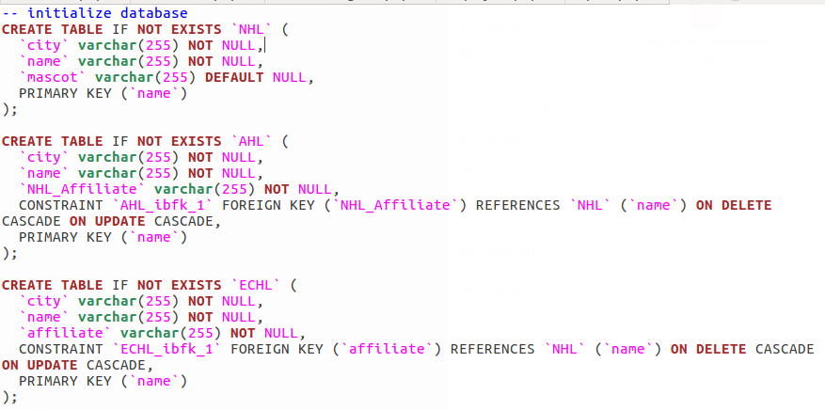
Integrity & Isolation

Slide 7
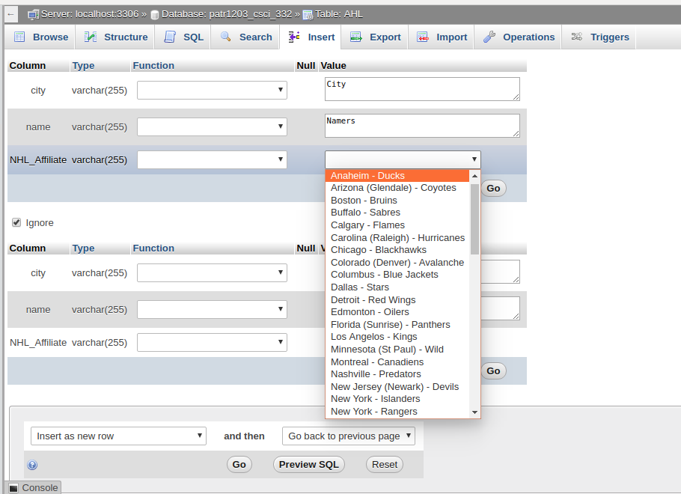
Integrity cont...

Slide 8
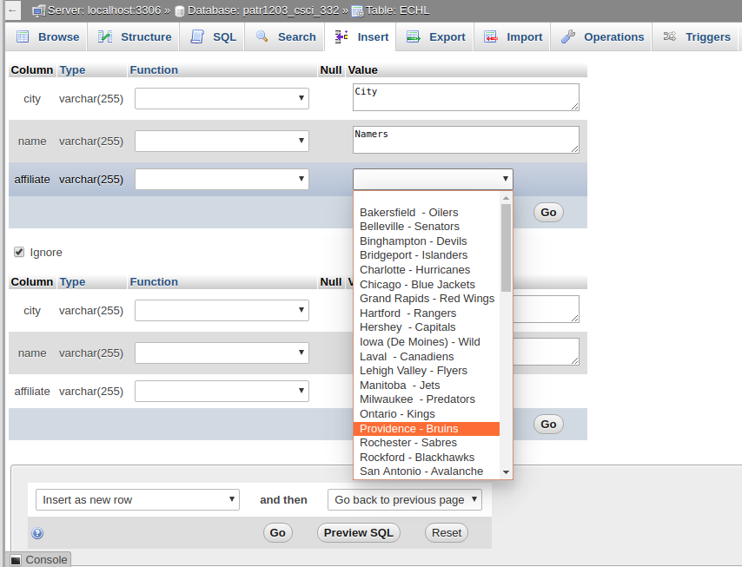
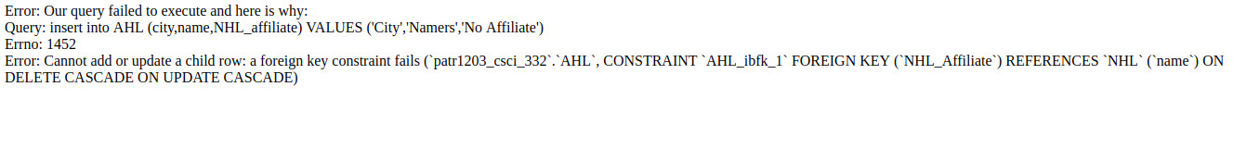
More integrity

Slide 9
Shortcomings so far
Attempted to implement an AFTER INSERT trigger
Unsuccessful so far
Function and Procedure to be implemented later on
Delete and log in progress
Report

Slide 10
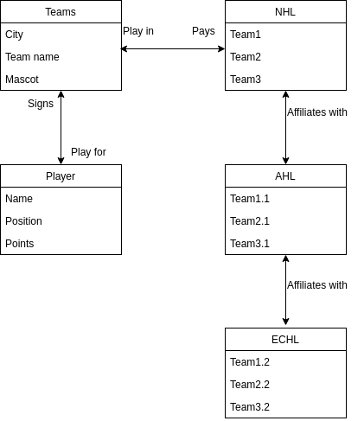
E/R Diagram

Slide 11
Questions?

Slide 12

Humboldt Hockey
https://www.gofundme.com/funds-for-humboldt-broncos

